Slide 1


Logistic Regression: A Comprehensive Guide
This presentation provides a comprehensive overview of logistic regression, covering its fundamentals, applications, and considerations for effective implementation.
by Pankaj Patil

Slide 2
What is Logistic Regression?
Binary Classification
Applications
Predicts the probability of a binary outcome (e.g., 0 or 1).
Spam detection, disease diagnosis, credit scoring, and more.

Slide 3
Logistic Function and Logit Function
Sigmoid Function
Logit Function
Maps any real-valued number to the (0, 1) interval.
Inverse of the sigmoid function, linear combination of features.

Slide 4

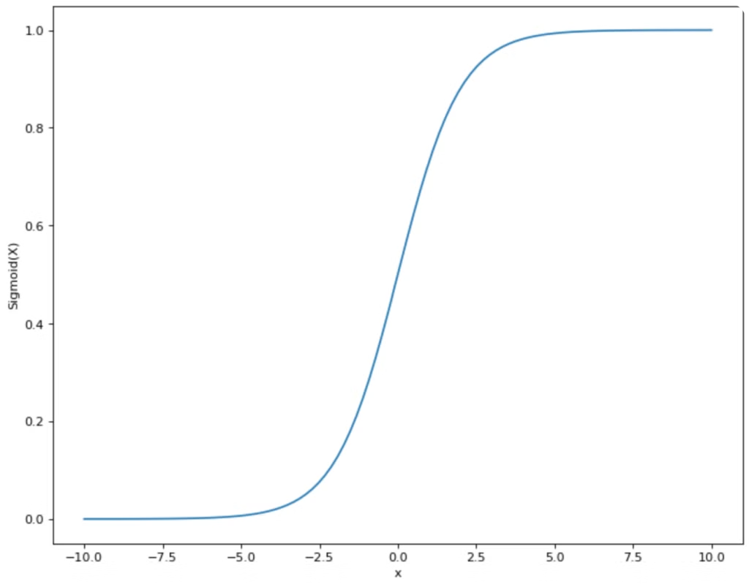
Logistic vs Linear Regression
Aspect
Logistic Regression
Linear Regression
Output
Probability (0 to 1)
Continuous value
Model Type
Classification
Regression

Slide 5
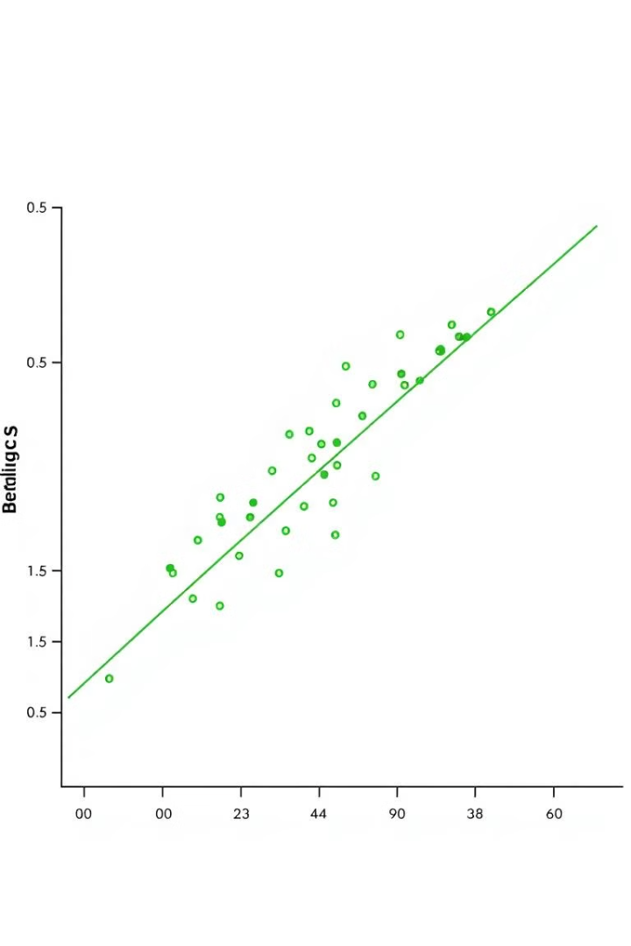
Assumptions of Logistic Regression
Perfect Separation
Multicollinearity
No feature should perfectly predict the outcome.
Features should not be highly correlated.
Outliers
Imbalanced Dataset
Logistic regression can be sensitive to outliers.
Struggles with imbalanced target classes.

Slide 6

How Logistic Regression Works
Step 1
1
Model the log-odds using a linear equation.
2
Step 2
Apply the sigmoid function to map the linear result to a probability.
Step 3
3
Choose a threshold to classify predictions as 0 or 1.
4
Step 4
Train the model using optimization techniques.

Slide 7
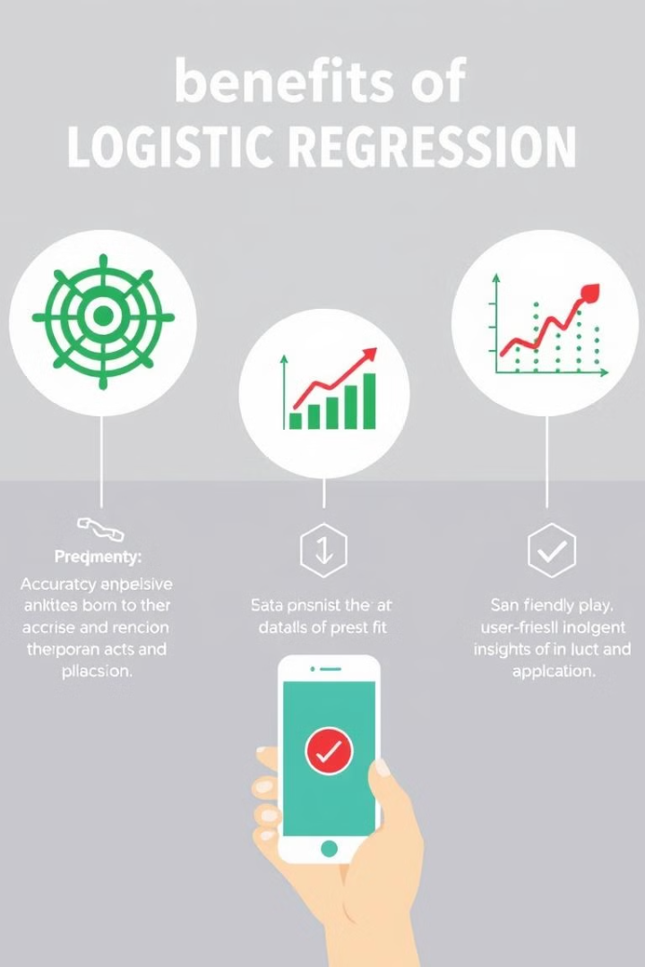
Advantages of Logistic Regression
Interpretability
Computational Efficiency
Easy to interpret and understand.
Faster to train on small datasets.
Linearly Separable Data
Probabilistic Output
Provides probabilities instead of just binary outcomes.
Works well when classes are clearly separated.

Slide 8

Disadvantages of Logistic Regression
Linear Boundaries
Sensitive to Outliers
Cannot capture non-linear relationships.
Outliers can skew results, especially in smaller datasets.
Large Feature Spaces
Imbalanced Data Issues
Performance degrades as the number of features increases.
Poor performance on highly imbalanced datasets.

Slide 9





Use Cases of Logistic Regression
Medical Diagnosis
Spam Classification
Predicting the presence or absence of a disease.
Identifying whether an email is spam or not.
Credit Scoring
Customer Churn
Determining whether a loan application is approved or denied.
Predicting whether a customer will leave a service.

Slide 10

When Logistic Regression Works Well
Linearly Separable Data
Binary Classification
Interpretability
Performs well when classes are separable through a linear boundary.
Best suited for problems with exactly two classes.
Useful when you need to understand the influence of features on predictions.

